Slide 1
3/12 Class 9 – Credit Card Transaction Fraud
Main types of financial fraud: origination (application) and transaction
Statistics about financial fraud
Project 2 was application fraud; Project 3 is transaction fraud
Credit card transaction fraud dynamics, data

Slide 2
What You’ve Learned So Far
How to approach and solve fraud problems
How to examine and clean large, messy data
How to handle missing fields and categorical fields
How to build variables using groupings, entities, ratios, normalizations, linking
How to scale variables and scores
Applied these principles to an unsupervised fraud problem
Forensic accounting rather than a real time fraud system
Two independent ways to build an unsupervised fraud score
In Project 2
Built a real time fraud system (where time flow is critical)
Built variables using link analysis, being careful about time flow
Built and evaluated a supervised fraud model
Project 3
Smaller, more sensitive data set
Examine $ tradeoffs for score cutoff analysis

Slide 3
Main Types of Financial Fraud
Application fraud. Fraud during the account opening process
Identity fraud - applying for a product under false credentials (id theft, synthetic, manipulation)
First party fraud – use your correct credentials but no intention to pay
Transaction fraud. Fraud during the account usage process
Credit card transactions
Money transfers from a compromised account (account takeover)
Insurance claims (auto, P&C, healthcare…)
Tax returns
…
Other scams. Nigerian, phishing, phone, charities, pyramids, mail, internet auction…
Project 2
Project 3

Slide 4
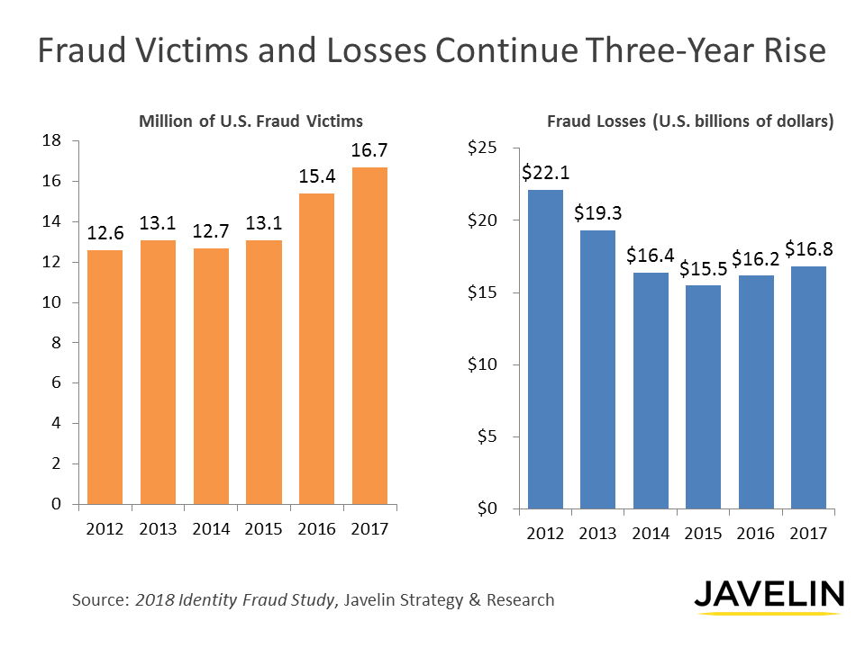

Slide 5
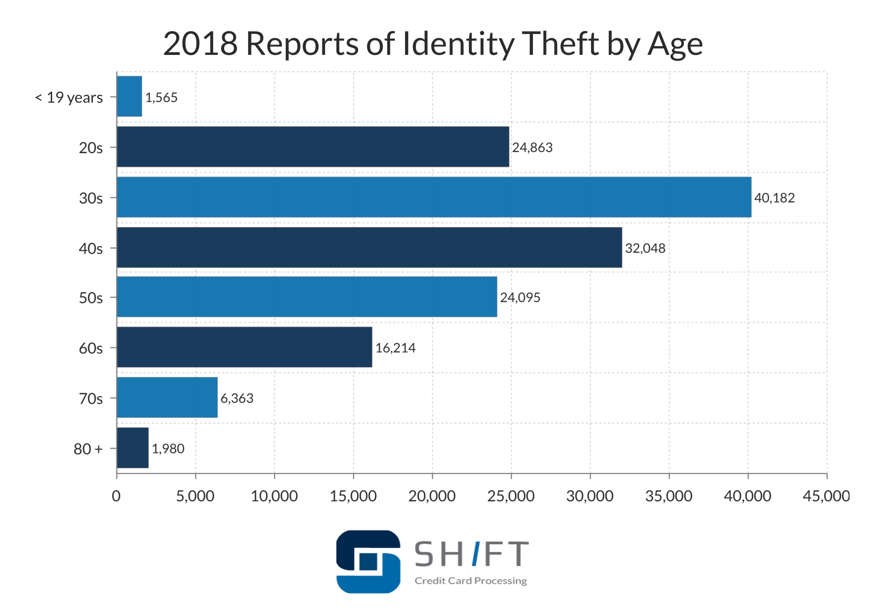
Break

Slide 6
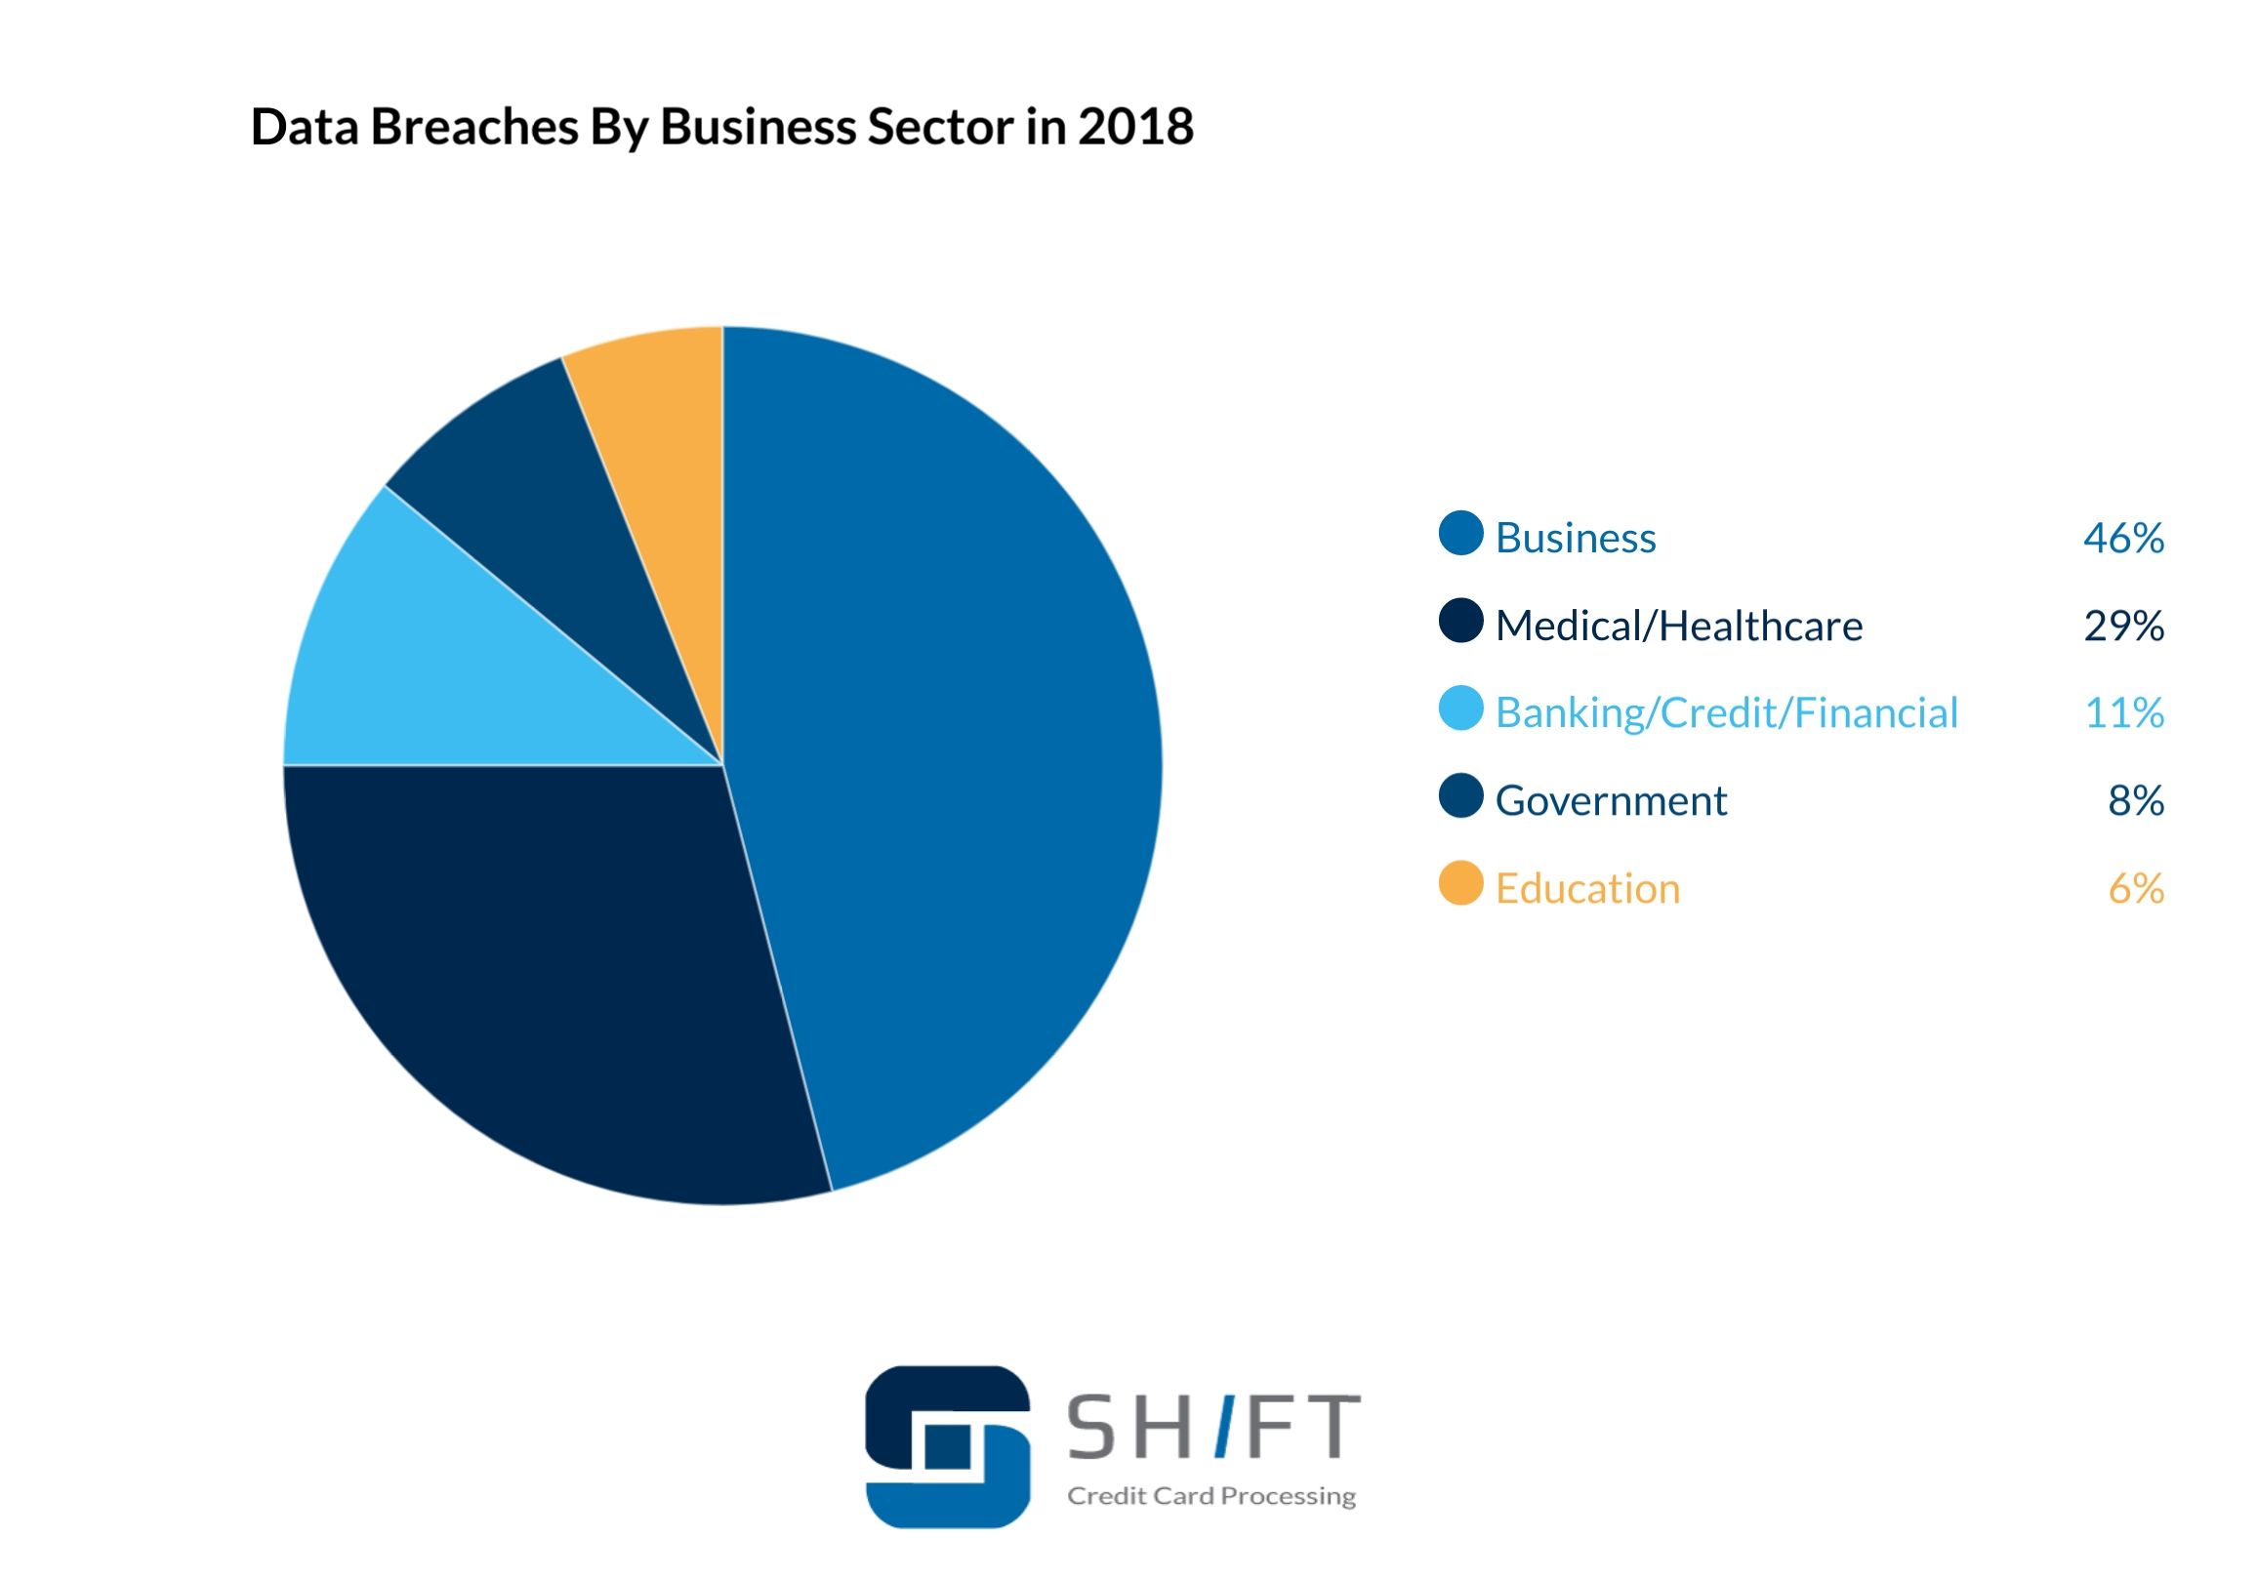
Break

Slide 7
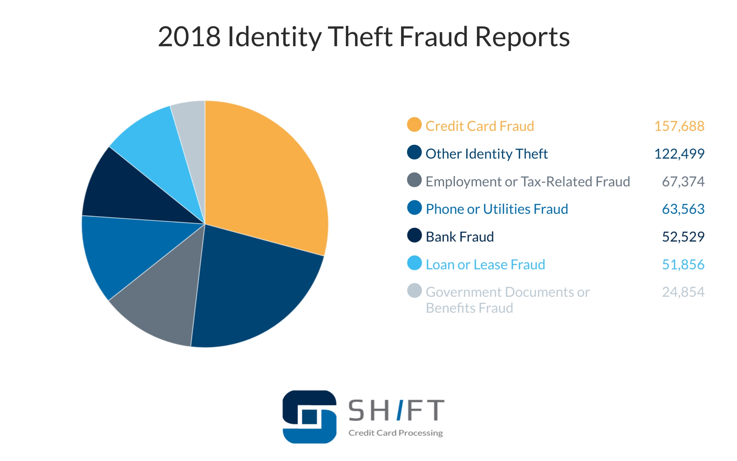
Break

Slide 8
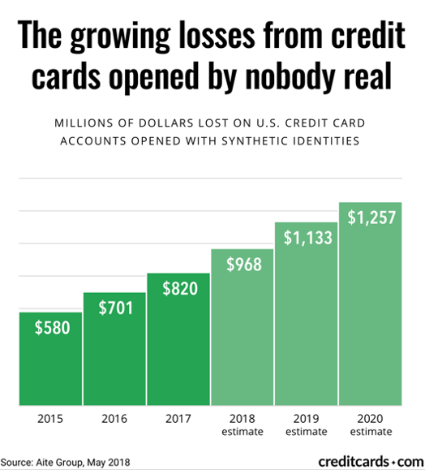

Slide 9
Main Types of Financial Fraud
Application fraud. Fraud during the account opening process
Identity fraud - applying for a product under false credentials (id theft, synthetic, manipulation)
First party fraud – use your correct credentials but no intention to pay
Transaction fraud. Fraud during the account usage process
Credit card transactions
Money transfers from a compromised account (account takeover)
Insurance claims (auto, P&C, healthcare…)
Tax returns
…
Other scams. Nigerian, phishing, phone, charities, pyramids, mail, internet auction…
Project 2
Project 3

Slide 10
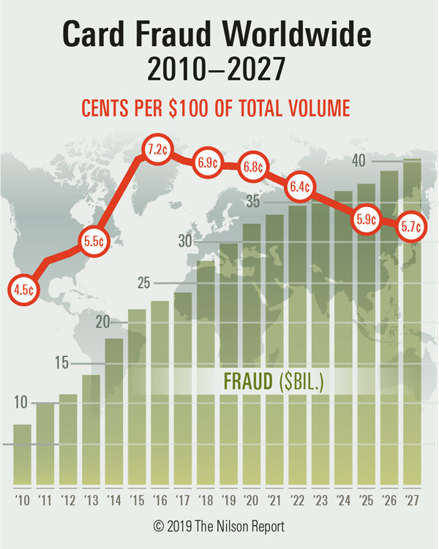

Slide 11
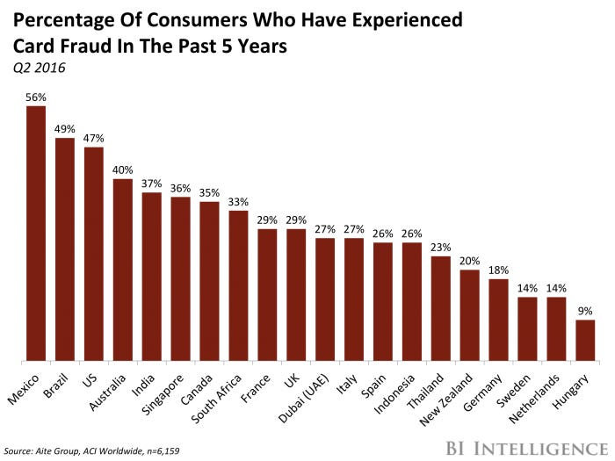

Slide 12
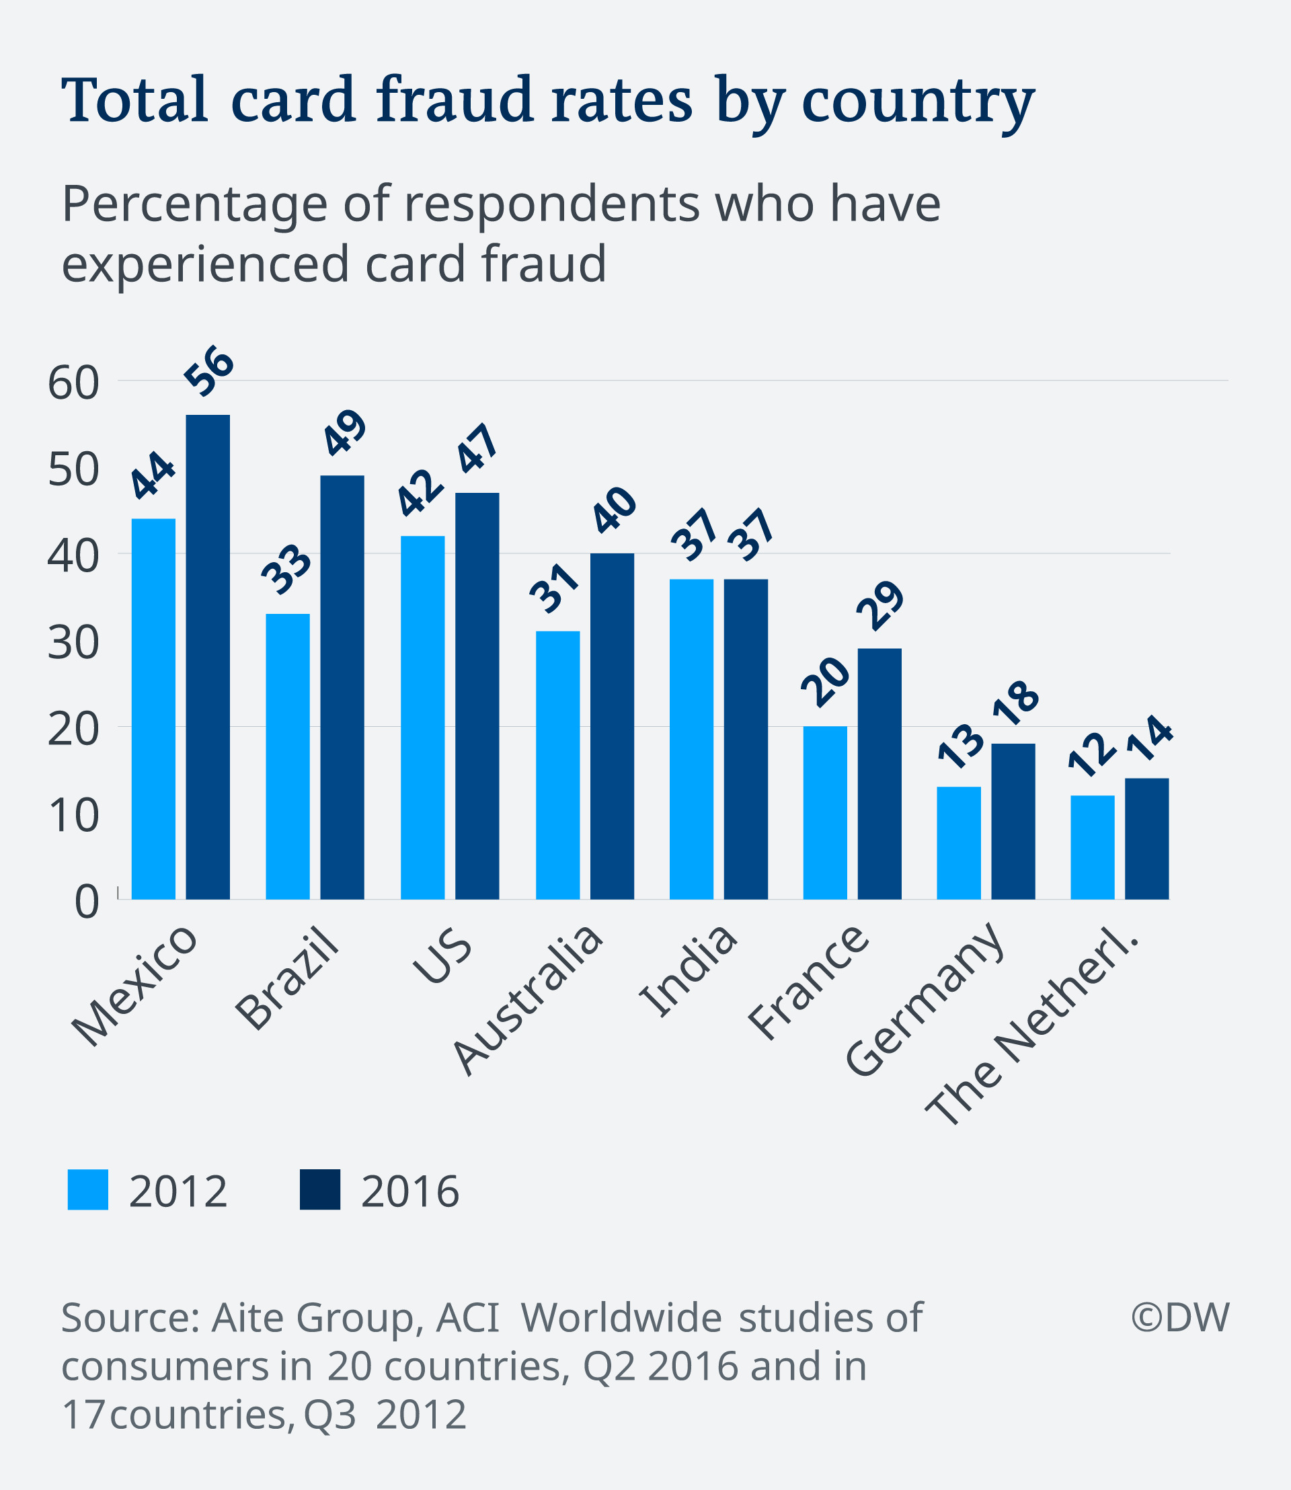

Slide 13
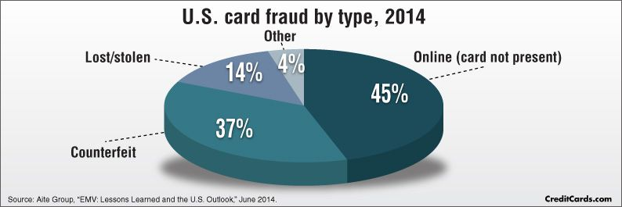

Slide 14
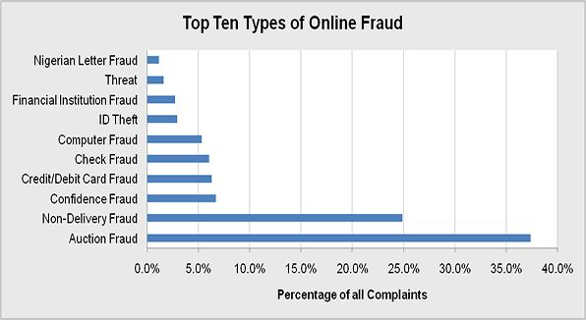
Modes of Online Fraud

Slide 15
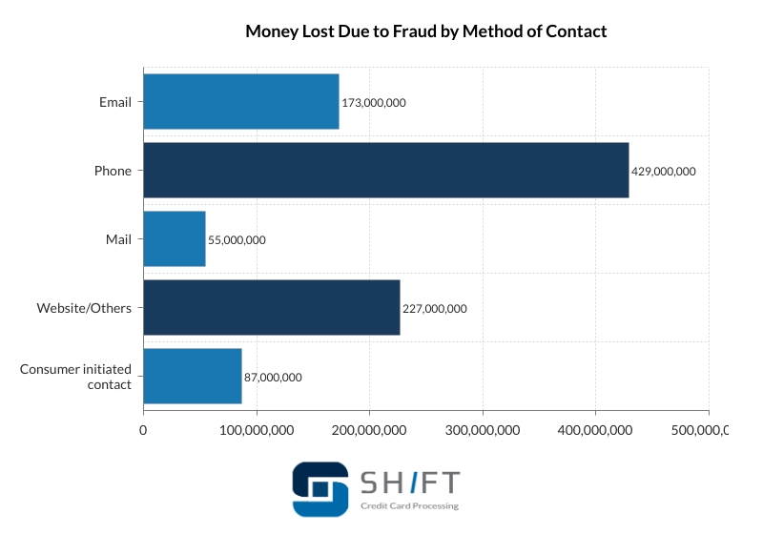
Fraud Scams

Slide 16
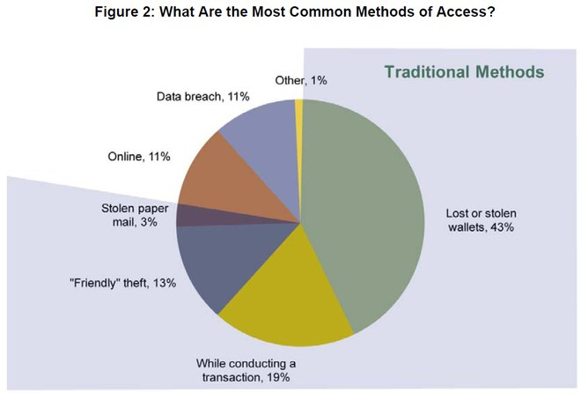

Slide 17
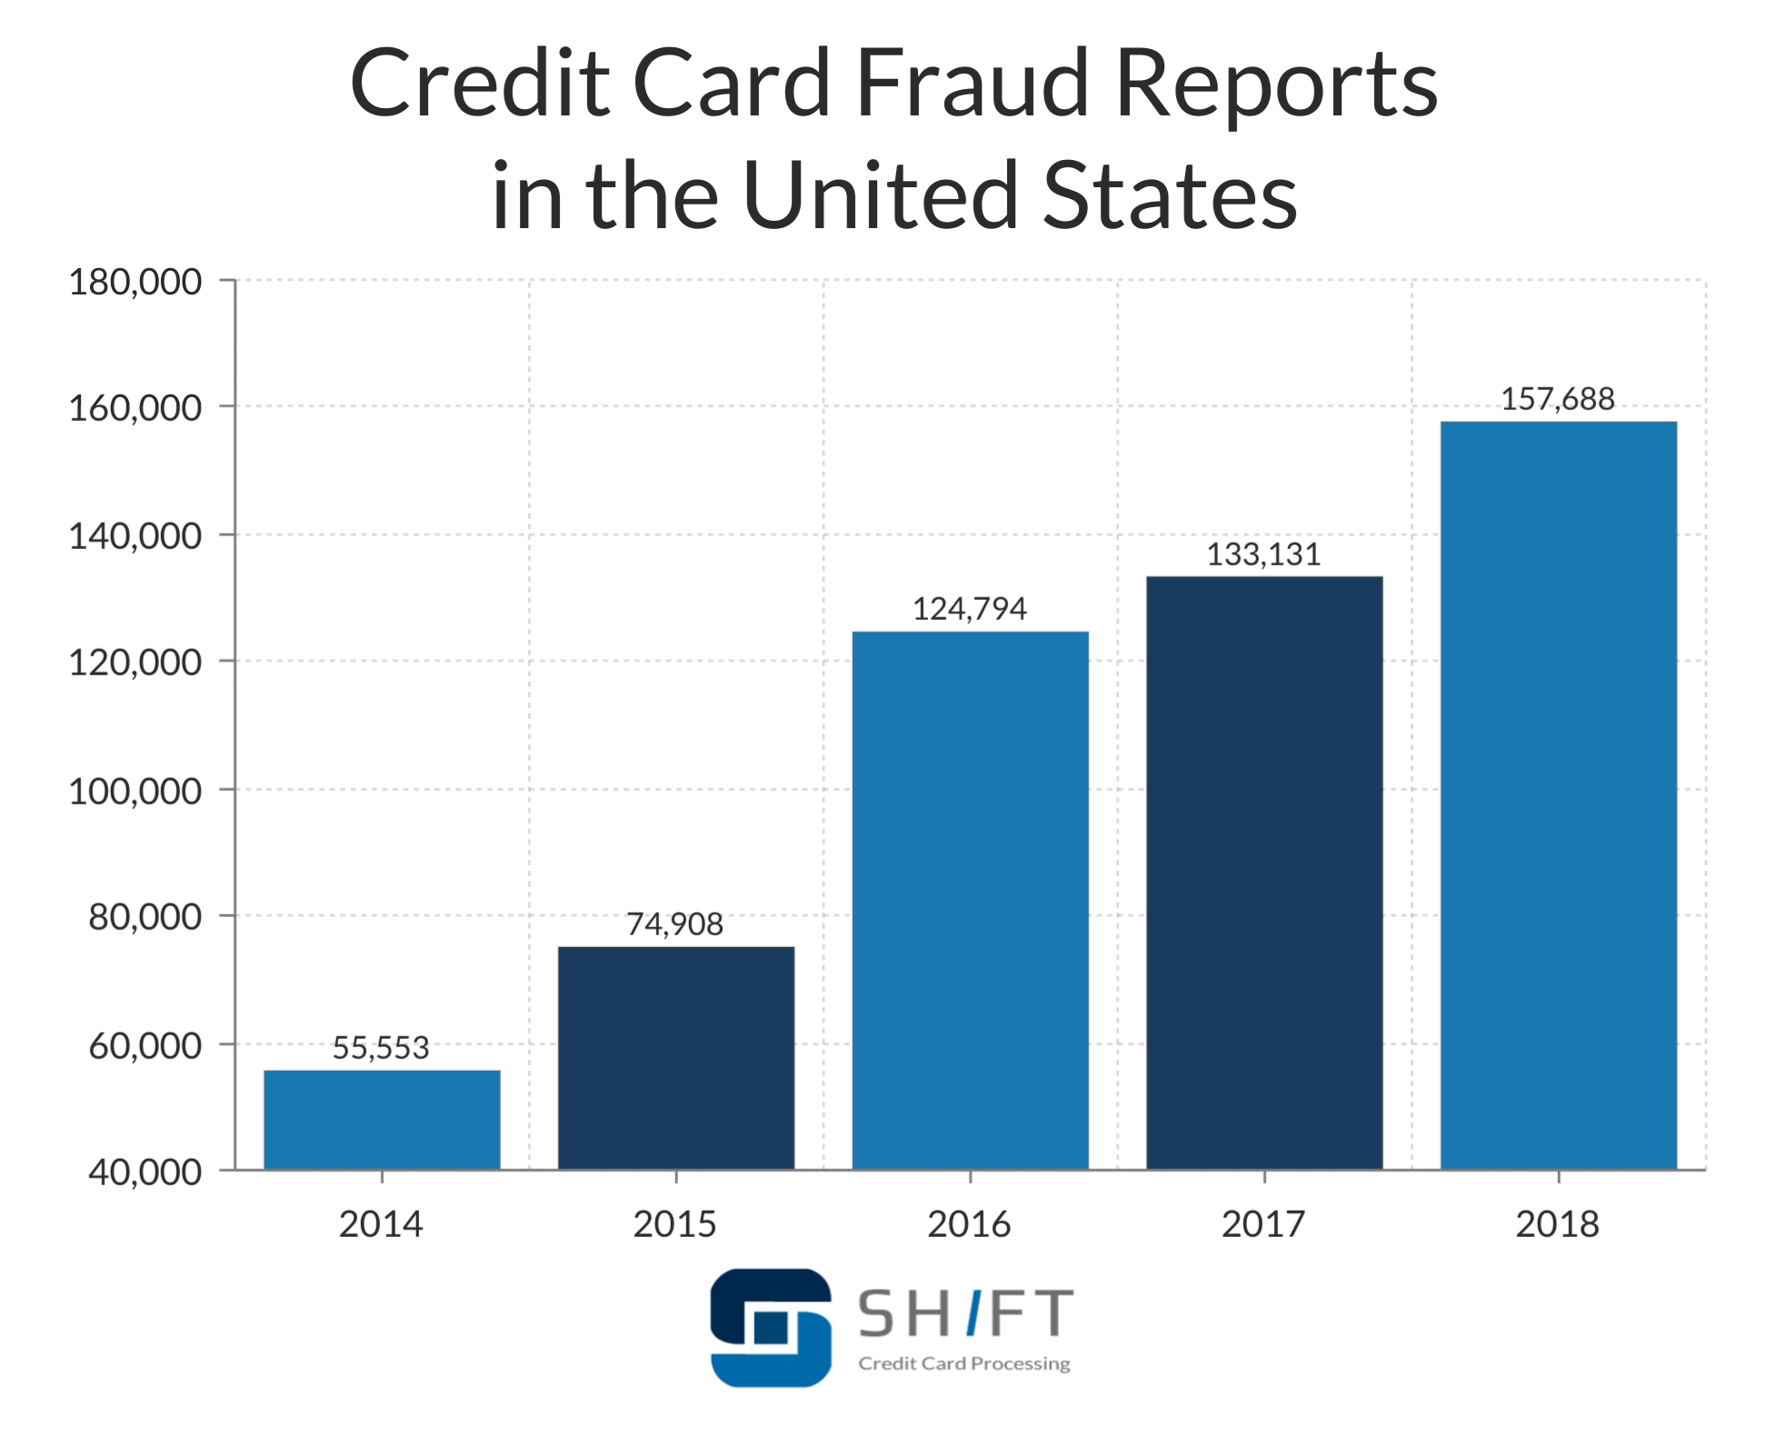
Break

Slide 18
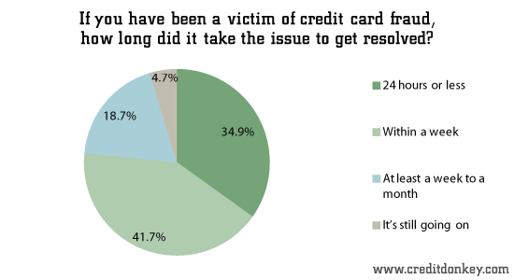

Slide 19
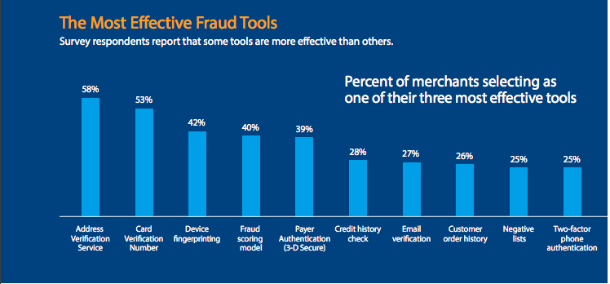

Slide 20
Credit Card Transaction Approval Process
Merchant
card swipe
Acquiring bank
(relationship with merchant)
Association network
(Visa, MC, Discover, Amex…)
Issuing bank
Runs fraud algorithm
(relationship with consumer)
Consumer
Relationship
All this happens in about 3 seconds

Slide 21
History of Credit Card Transaction Fraud Detection
Credit cards introduced in the 1950s
Weekly hot list of bad (lost/stolen) accounts
Rule-based expert systems (if this, then flag as fraud)
HNC (FICO) first widespread commercial fraud product
Transaction profiles (1992)
Falcon (1993) – supervised neural net
Quickly became the dominant, global solution by late 1990s
Other small, boutique neural net fraud products
Early 2000s other big player build products
SAS, IBM, BAES, VISA, MC…
Now many products, FICO Falcon still dominant

Slide 22
Falcon History and Processes
Robert Hecht-Nielsen and Todd Gutschow start HNC Software in San Diego (1986)
Tried to commercialize neural net technology
Searched for a practical use
Stumbled on credit card fraud detection (Allen Jost). Huge success! Patent filed 1992. IPO 1995. Bought by FICO 2002.
Falcon – supervised neural net
Data: transaction “swipe” (card #, $ amt, day/time, merchant..)
Use concept of profiles (typical behavior for the card/merchant)
Build many hundreds of candidate variables
Fraud labels supplied by contributing banks
Trained offline, implemented at issuing bank (mainframe)
Model retrained every few years
Falcon Workstation for investigation and case management

Slide 23
Credit Card Fraud Modes
How account compromised:
Existing account:
Lost/stolen
Intercepted (skimming) -> counterfeit
Other account takeover (online hack…)
At origination:
Never received issue (NRI) (stolen out of mail)
Application fraud/Identity fraud
Point of sale (POS) differences:
Card present (CP)
Card not present (CNP) - internet, phone, mail
Latest evolving fraud dynamics:
Introduction of chip (EMV) (Eurocard, Mastercard, Visa)
CP -> CNP
Counterfeit -> application/identity fraud
Transaction Fraud
Application Fraud

Slide 24
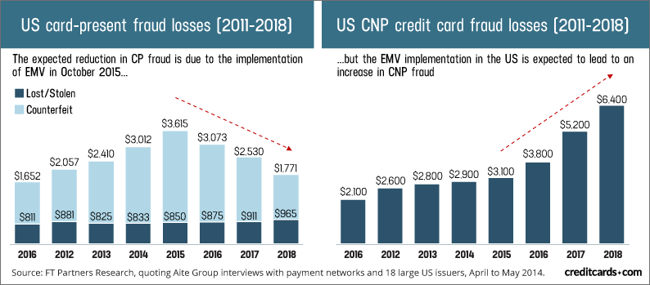
Since introduction of chips, fraud has migrated from counterfeit to CNP and applications

Slide 25
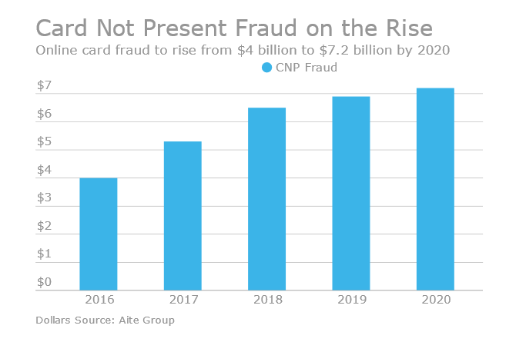

Slide 26
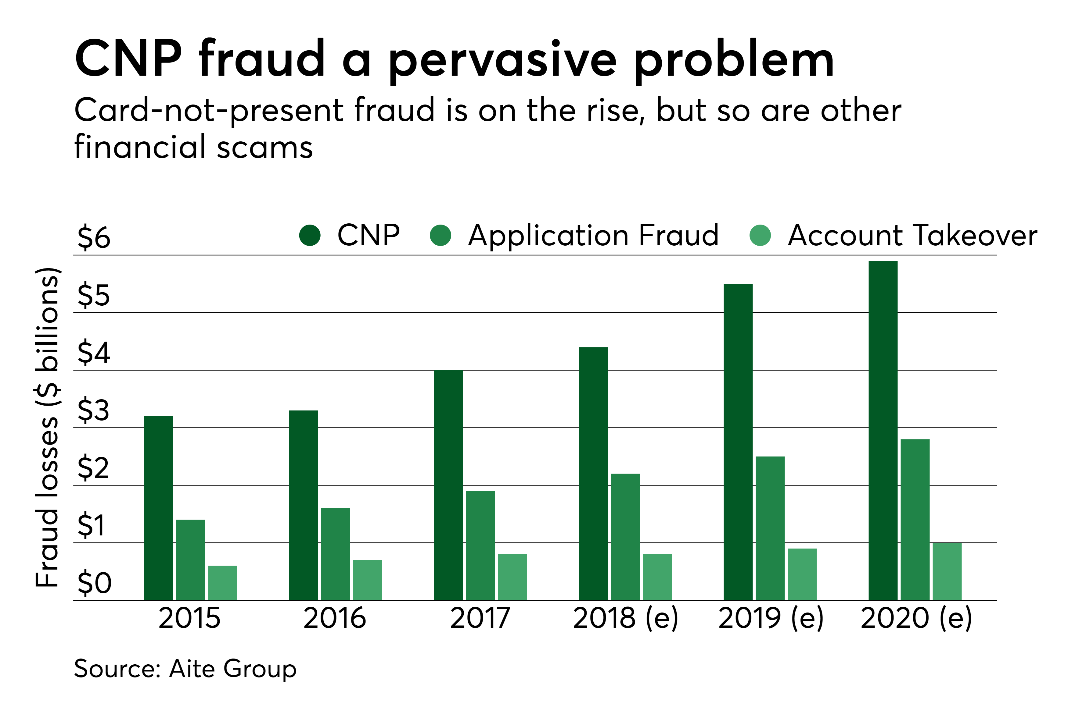

Slide 27
Credit Card Transaction Fraud Signals
How account compromised:
Lost/Stolen card. Someone steals your card or you lose it, and someone uses it.
Common point of compromise. Someone at a merchant “steals” many cards. Makes counterfeit cards. Skimmers at gas stations, ATMs, restaurants, stores…
Online account hacked. Someone gets your username/password and gets card info from online account
Signals of fraud:
Burst of activity at different merchants
Larger than normal purchase amounts, same or different merchants
Used at merchants not used before for that card
Used at a very different geography
Used at a high risk merchant (online, jewelry, electronics…)
Increased usage in card-not-present
Employee or merchant invents transactions
Infrequent recurring charges, same amount or same merchant
Employee or merchant invents a fictitious merchant
Think about these signals for making variables

Slide 28
Credit Card Transaction Data for Project 3
About 96,000 records, ~1,000 frauds. These are the only fields we have.

Slide 29
Project 3. Card Transaction Fraud
Build a supervised fraud model on the card transaction data. Use proper methodology: data cleaning, variable creation, training, testing, OOT, appropriate algorithms, proper treatment of time.
For this problem you’ll again build many candidate variables (hundreds) and then use feature selection methods to reduce the number of variables.
Prepare a report showing the details of the project. Use good formatting, good grammar/spelling, be complete, full DQR in an appendix.
For this problem you will have fraud labels (supervised), and you can quantitatively assess model performance, which should be in your report.
The report is identical for all members on the team, but each team member turns in a copy on Blackboard to be graded.
Each team will make a ppt presentation of their results
Report due 4/26 midnight

Slide 30
Steps for Supervised Fraud Algorithm (Project 3)
Understand the business problem and fraud modes
Explore data and do a DQR
Build expert variables
Divide the data into training_testing/out of time (OOT)
Perform feature selection (filter, wrapper)
Try many models and parameter combinations. Examine model performance and redo/adjust as needed.
Finalize model, build three evaluation tables (trn, tst, oot)
Write report

Slide 31
Homework 7: DQR on Credit Card Transaction Data
Build a Data Quality Report for the card transaction data
Report should be a Word document or pdf
Professional business report: complete, good formatting, good grammar, no spelling errors
Good formatting on all your data plots: good choices of scales (log, linear, ranges), legible labels
Due 3/26

Slide 32
Data Preparation and Modeling Process
Assemble data, time frames, populations, exclusions
Perform basic statistics: field populations, percentages, field distributions, do a Data Quality Report (DQR)
Interact with domain experts, decide entities, clean the data, construct all variables
Decide training, testing, out of time samples
Build simple baseline linear/logistic model
Build many nonlinear models. Try many methods and parameters.
Candidate final model: examine important inputs. Do they make sense? Beware of models that perform too well.
Iterate candidate final model with business leaders. Are all the inputs OK? Performance OK?
Finalize models, deliver, document

Slide 33
Look at Credit Card Transaction Data
Walk through data exploration notebook

